Slide 1


AMERICAN UNIVERSITY Online Marketing Strategy Analyses
ITEC – 660: BUSINESS INTELLIGENCE
COURSE PROJECT BY:
GROUP SEVEN [7]

Slide 2
Objectives
Assess AU's Online Marketing Effectiveness
Analyze the Findings on Enrollment, Marketing, Demographics, and Costs
Provide Recommendations Based on Findings

Slide 3

Has American University's Marketing Strategy Failed?

Slide 4
Findings/Insights
Large states with metropolitan centers had the biggest contribution to enrollment
02
Online marketing inadvertently increased in Bachelor enrollment
03
From 2012-2017, AU spent ~ 2.3M per lead
01
AU strategy has not failed! YAY
04

Slide 5
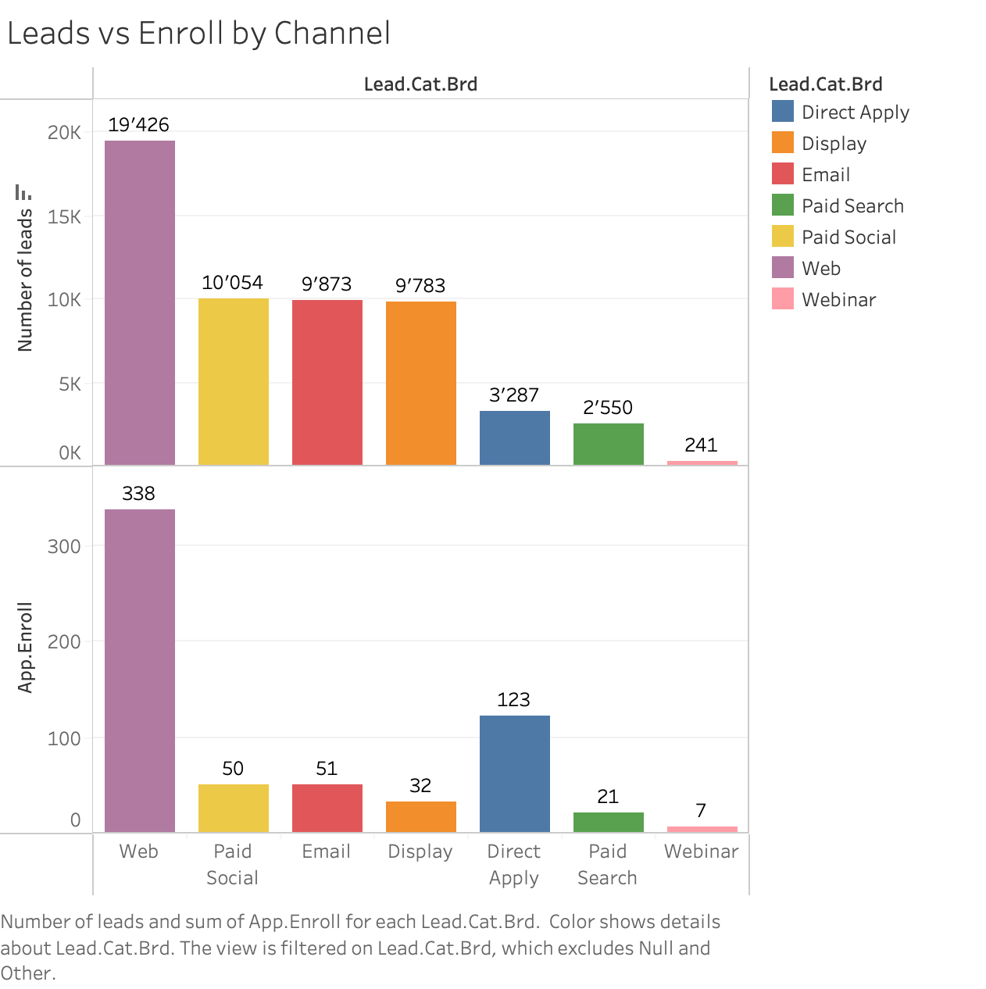
Enrollment Leads Outcome
Web generated over 50% of Enrollments
At the moment, it is the most effective method of achieving enrollments

Slide 6
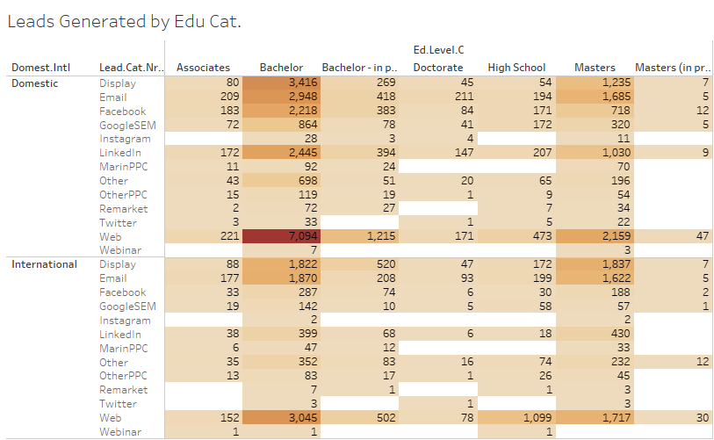
Leads Generated by Education Category
The web method is very effective in generating leads from both domestic and international students
Social network methods generate fewer leads for international students than for domestic students
Twitter and Remarketing methods draw the least attention from students
The university can invest into faculty responses to master's enrollment related emails since emails were very effective in generating master's enrollment

Slide 7
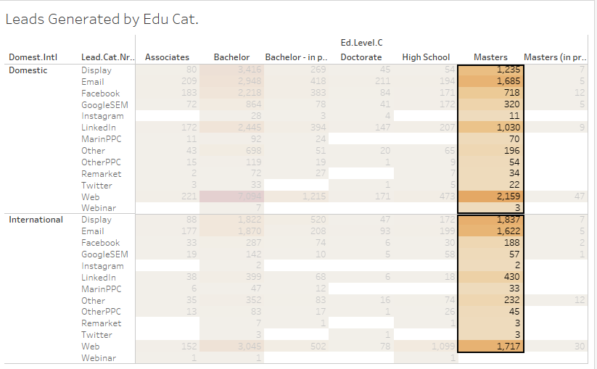
Leads Generated by Education Category
The web method is very effective in generating leads from both domestic and international students
Social network methods generate fewer leads for international students than for domestic students
Twitter and Remarketing methods draw the least attention from students
The university can invest into faculty responses to master's enrollment related emails since emails were very effective in generating master's enrollment

Slide 8
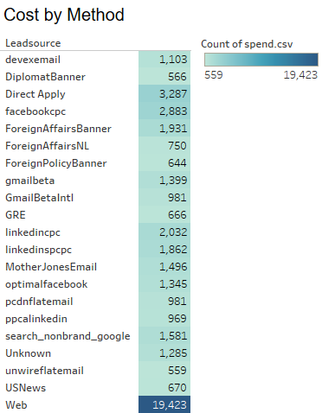
Lead Source Cost by Method
The lead source that generated the most advertising spend was "Website", which shows that AU is getting value for its money with the spend on website
The "Direct Mail" and "Email" sources had relatively low levels of advertising spend compared to the other sources which makes intuitive sense but an introduction of an incentive for emails may be profitable in the long run
Also, the vast difference in the count of spend suggests that AU may be focusing its advertising efforts on a relatively small number of channels and that there may be opportunities to diversify its advertising strategy to reach new prospects

Slide 9
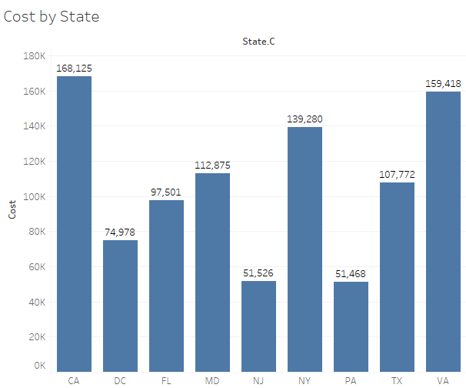
Marketing Spend Analysis by State
Top Spender: California (CA) leads with the highest marketing spend at $168,125, followed by VA and NY
Lower Spend States: New Jersey (NJ) and Pennsylvania (PA) have lower spending around $51,500
Moderate Spend States: Texas (TX) and Florida (FL) have moderate spends of approximately $107,772 and $97,501, respectively

Slide 10
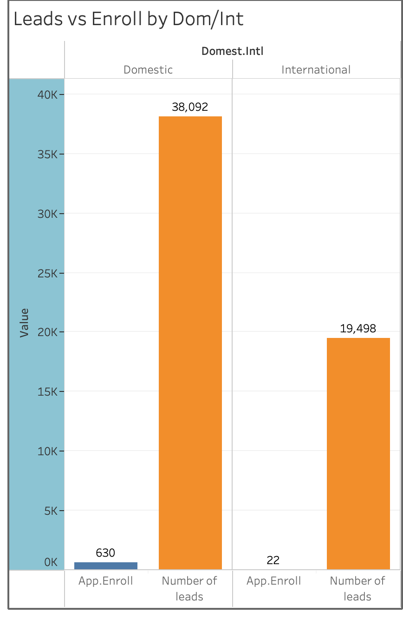
Lead vs Enroll: International vs. Domestic
The overall lead for both Domestic and International students combined is 57,590.00,
Domestic students have a marginally higher lead of 38,092 compared to International students at 19,498.
Enrollment for International is at a low of 22 compared to enrollment from Domestic at 630.

Slide 11
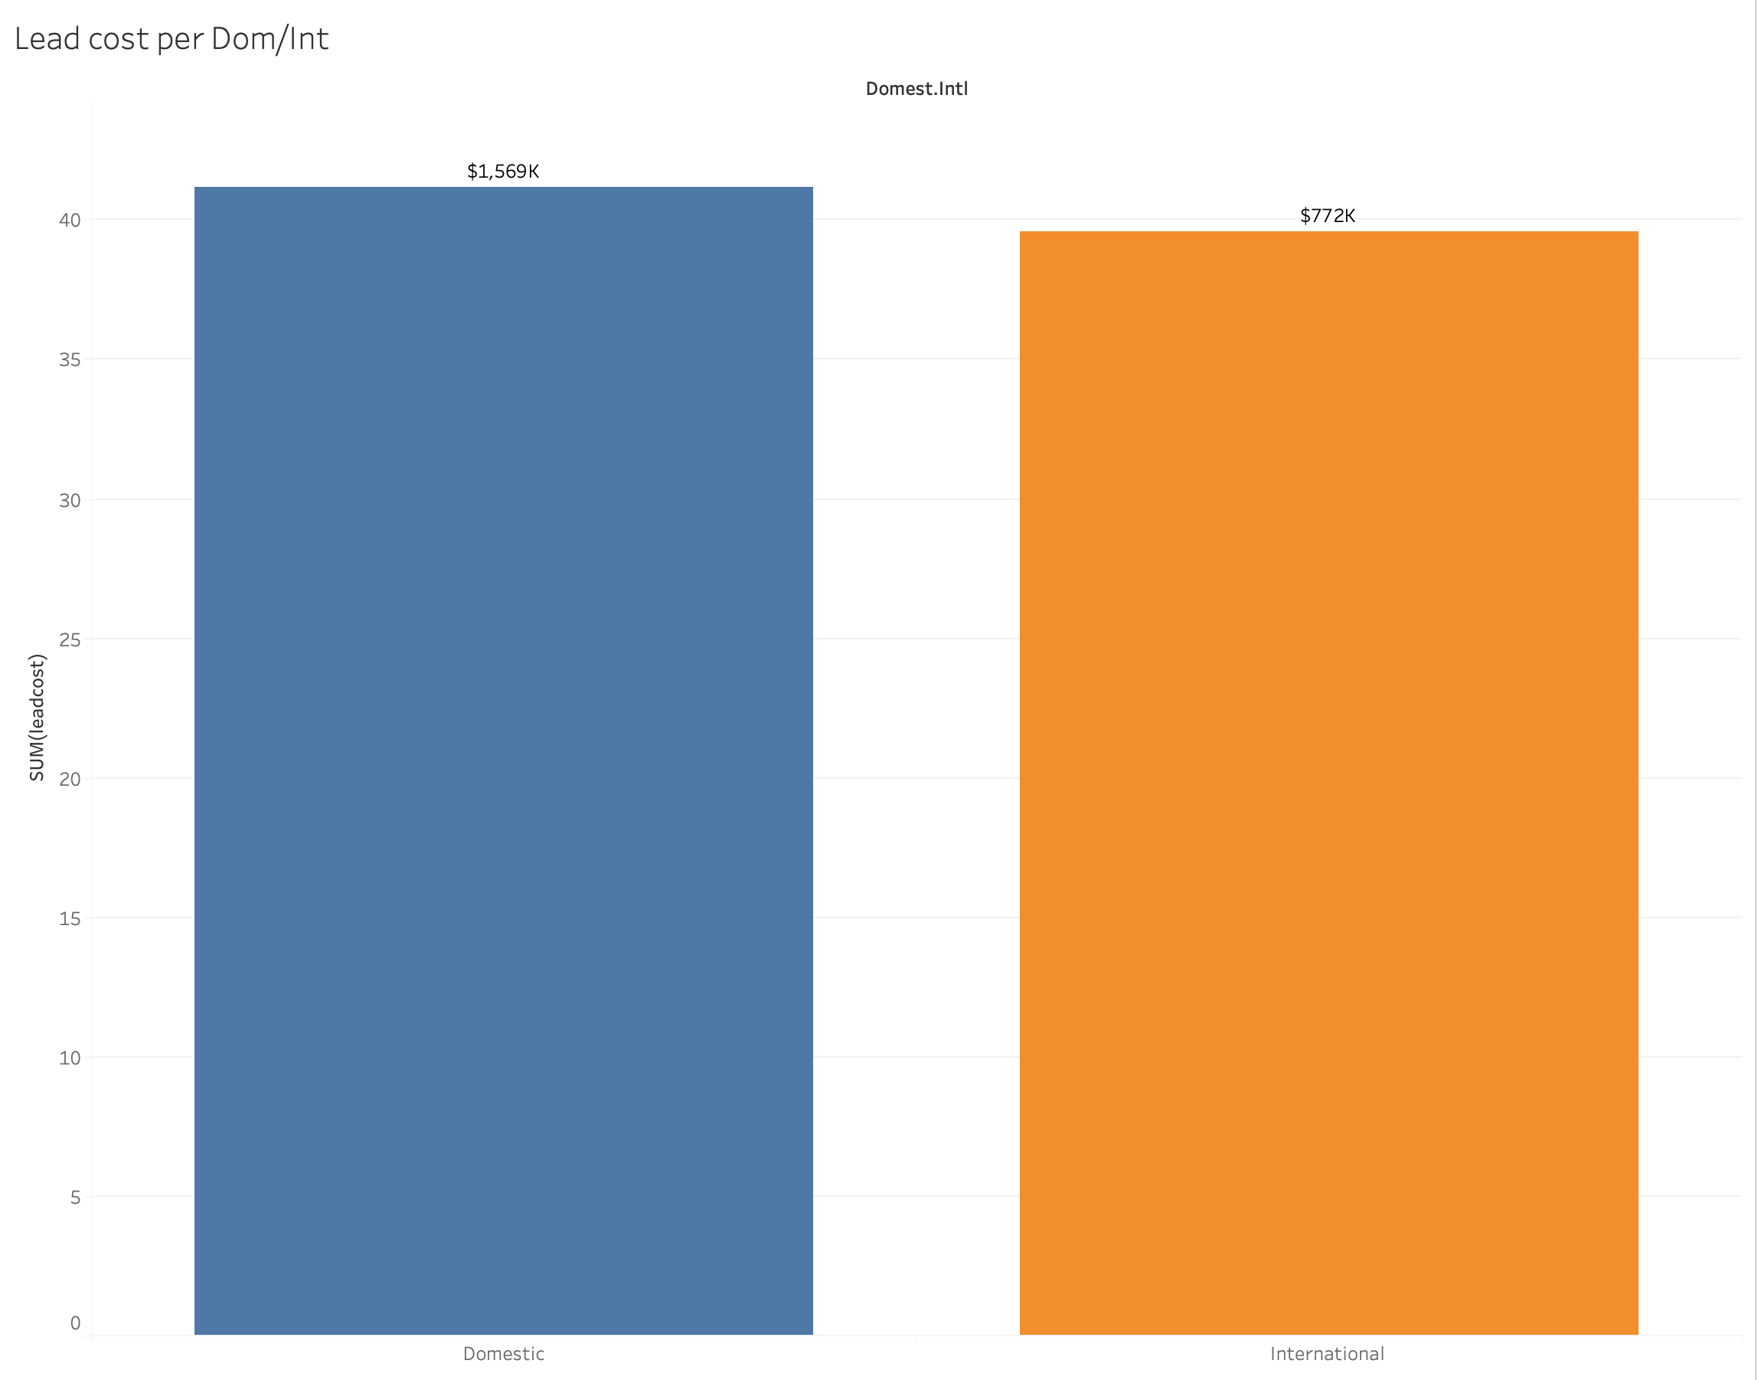
Lead cost by Dom./ Int. Students
The cost per lead for Domestic students is $1,569,000
International students has a lead cost at $772,000
This shows that acquiring a domestic lead is more than twice as expensive as acquiring an international lead.

Slide 12
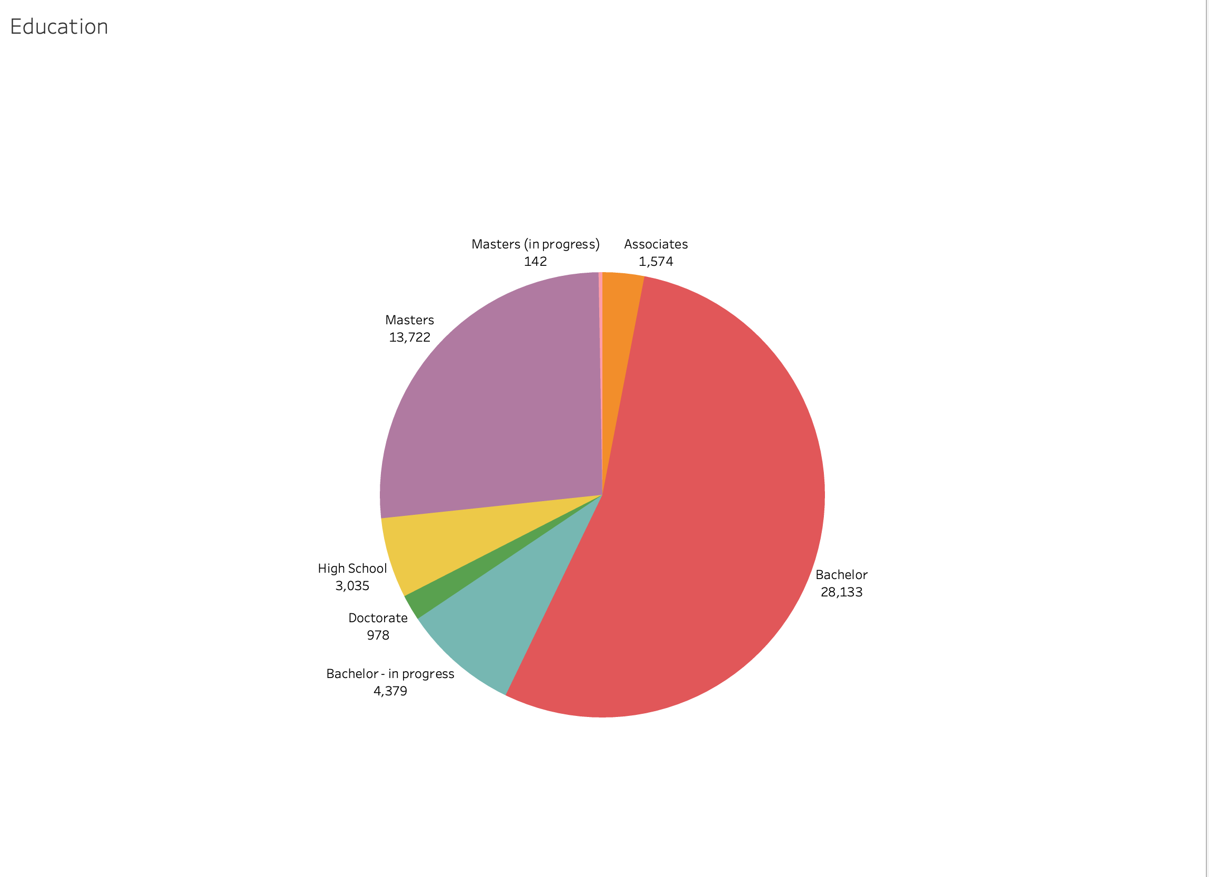
Lead by Previous Education of Enrolled Students
Over 50% of Enrolled Students have bachelor’s degree as their prior education
About 27% of Enrolled Student’s previous education has a master’s degree

Slide 13
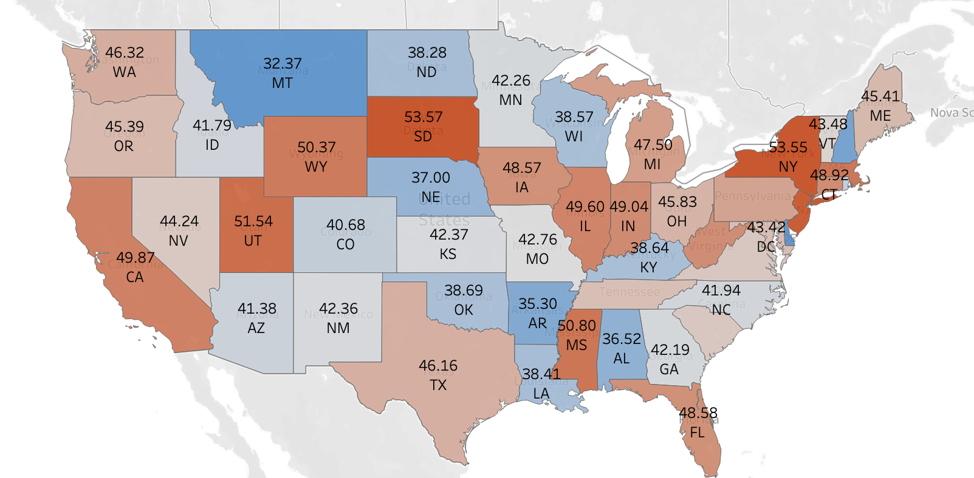
Average Lead Cost by State
Average Lead Cost by State
The states with the highest lead costs are New York(53.55), New Jersey(53.01) and South Dakota(53.57)
The states with the lowest lead cost are Montana(32.37), New Hampshire(34.40), and Delaware(32.27)

Slide 14
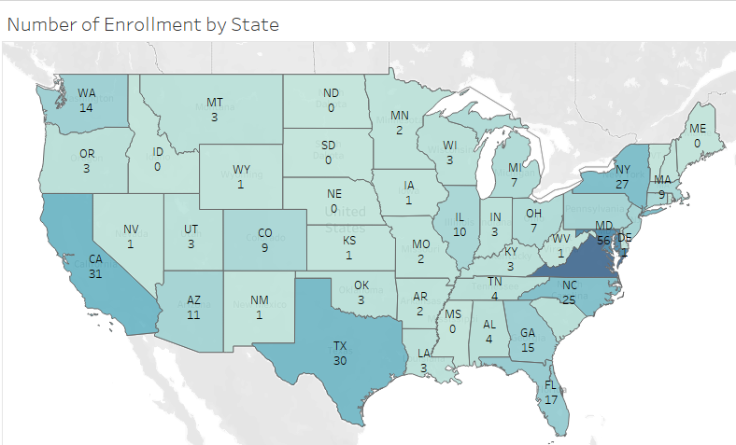
Enrollment Rate and Lead Cost Analysis by State
Surprisingly, Montana has the highest Average enrollment rate with the lowest lead cost
South Dakota has the most expensive lead cost, but the enrollment rate is 0
Enrollments predominantly come from states with larger populations
Schools should conduct online recruiting in states with larger populations even the cost is higher

Slide 15
Recommendations
Improve Website and Online Reputation
Retain bachelor graduates for master’s programs
Invest more in states with high enrollment rates
Evaluate and optimize marketing and enrollment costs
Attract more international students

Slide 16
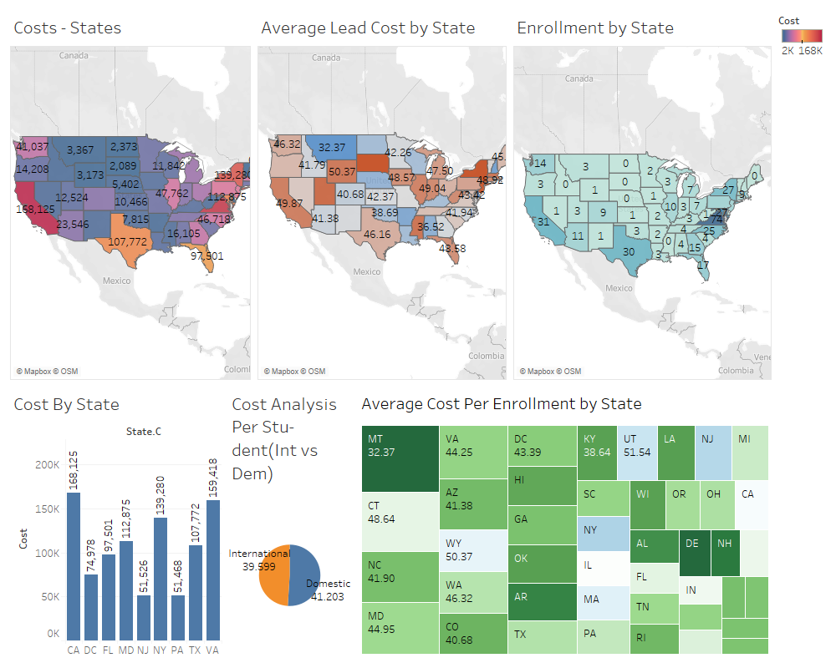
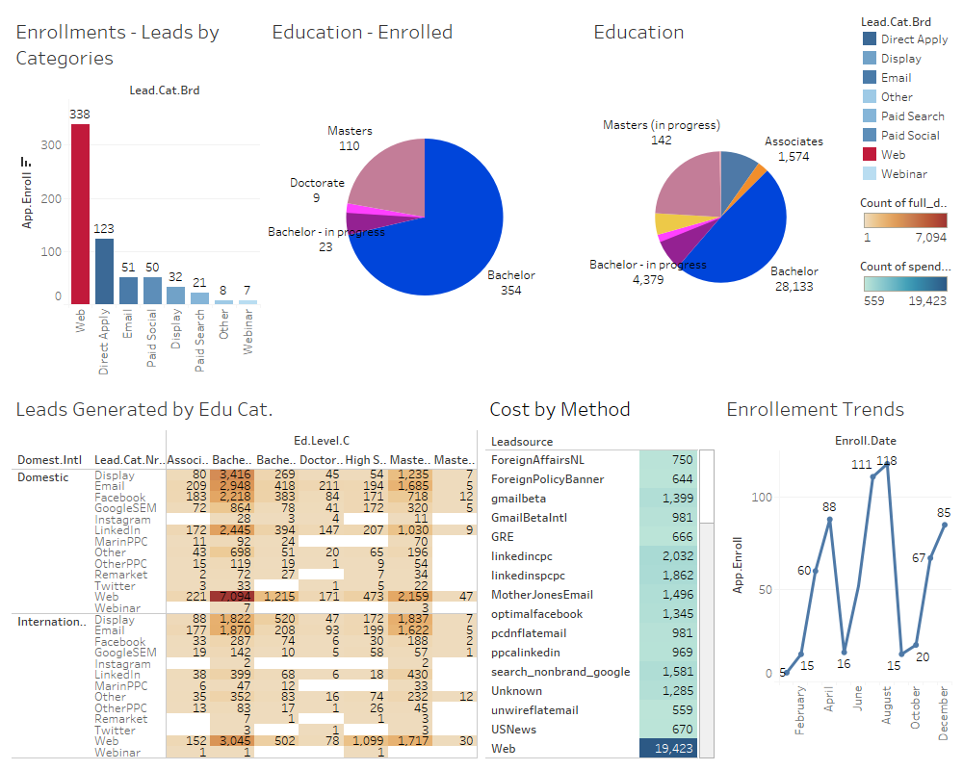

Slide 17

Thank You!
Q&A

Slide 18
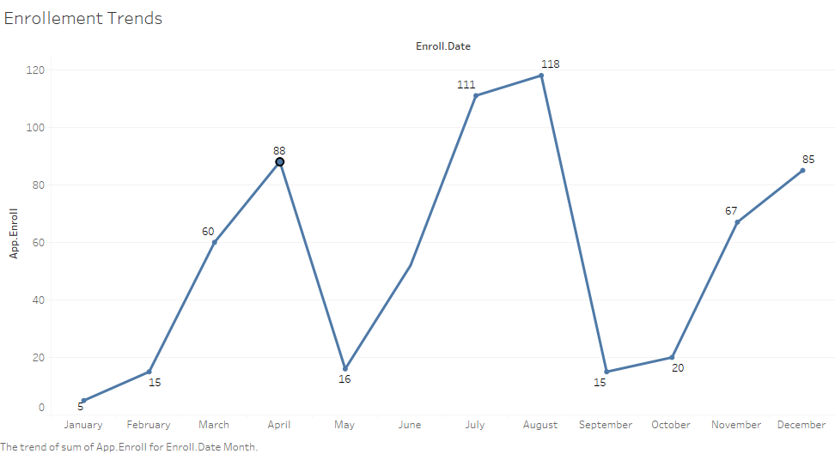
Enrollment Trends
May
Upward trend in enrollment numbers with a notable drop in May, implying consistent growth till April
July and August
The months of July and August registered the most significant number of enrollments
April
Indicates variations in enrollment numbers with April having the highest number of enrollments, followed by a drop in May and a steep increase in July
Sep.–Oct.
Enrollment numbers decreased from September to October, but picked up again from October to December

Slide 19
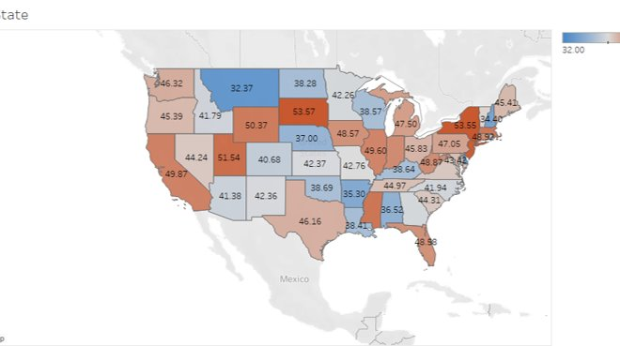
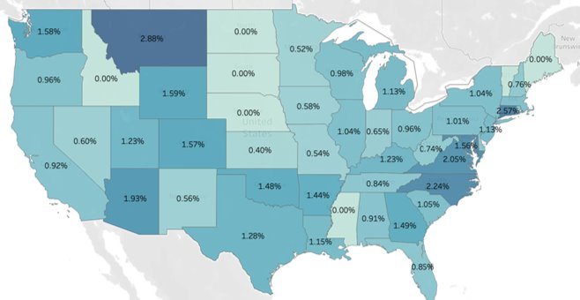
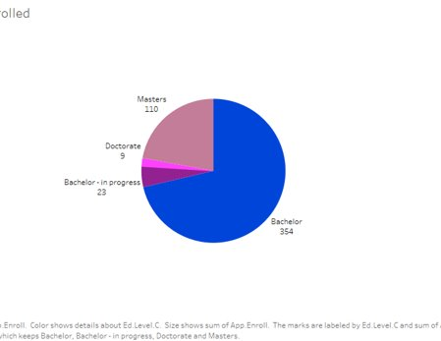
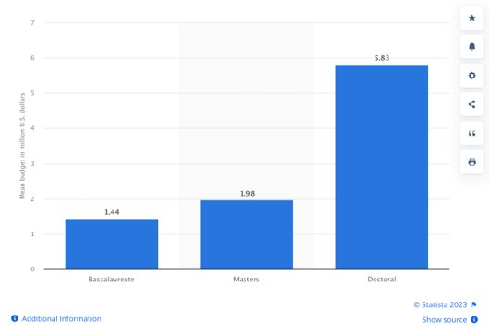

Slide 20
Recommendations
Enhance marking strategies by allocating increased budget to states with a proven track record of higher enrollment rates
Enhance the university's website to provide a seamless user experience, as it accounts for 52% of enrollments.
Focus on user satisfaction by implementing a responsive design, easy navigation, and relevant content
Strengthen the university's online presence across social media platforms, Wikipedia, and other relevant web channels to expand its reach and reputation
Maintain the focus on allocating marketing resources to states with high enrollment rates.
Explore opportunities for strategic partnerships in other states to increase enrollment from underrepresented regions
Increase bachelor retention post-graduation for Masters' programs.
The university should assess the cost-effectiveness of their marketing and enrollment strategies for both Domestic and International students. By evaluating key metrics such as conversion rates, retention rates, and the average cost per enrolled student, they can identify areas for improvement and optimize resource allocation

